Slide 1

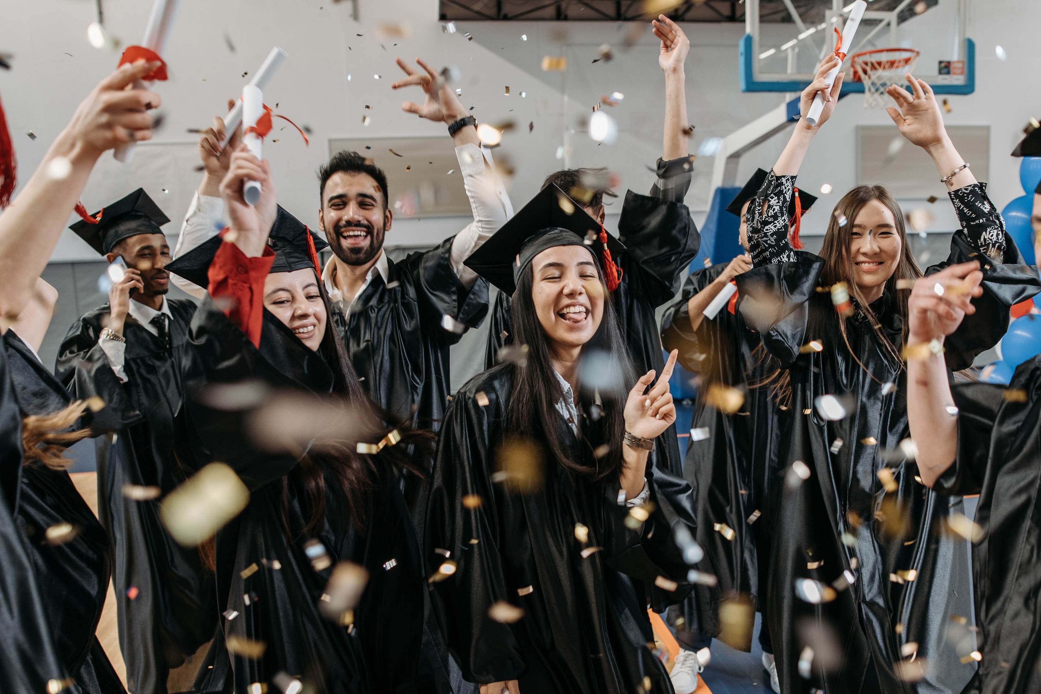
Peter Skene Ogden Secondary School
Grad Class of 2025 Digital Thank you Book
Our Grade 12 students have shared their heartfelt gratitude to family, friends and staff.
Sit back and enjoy their messages!

Slide 2
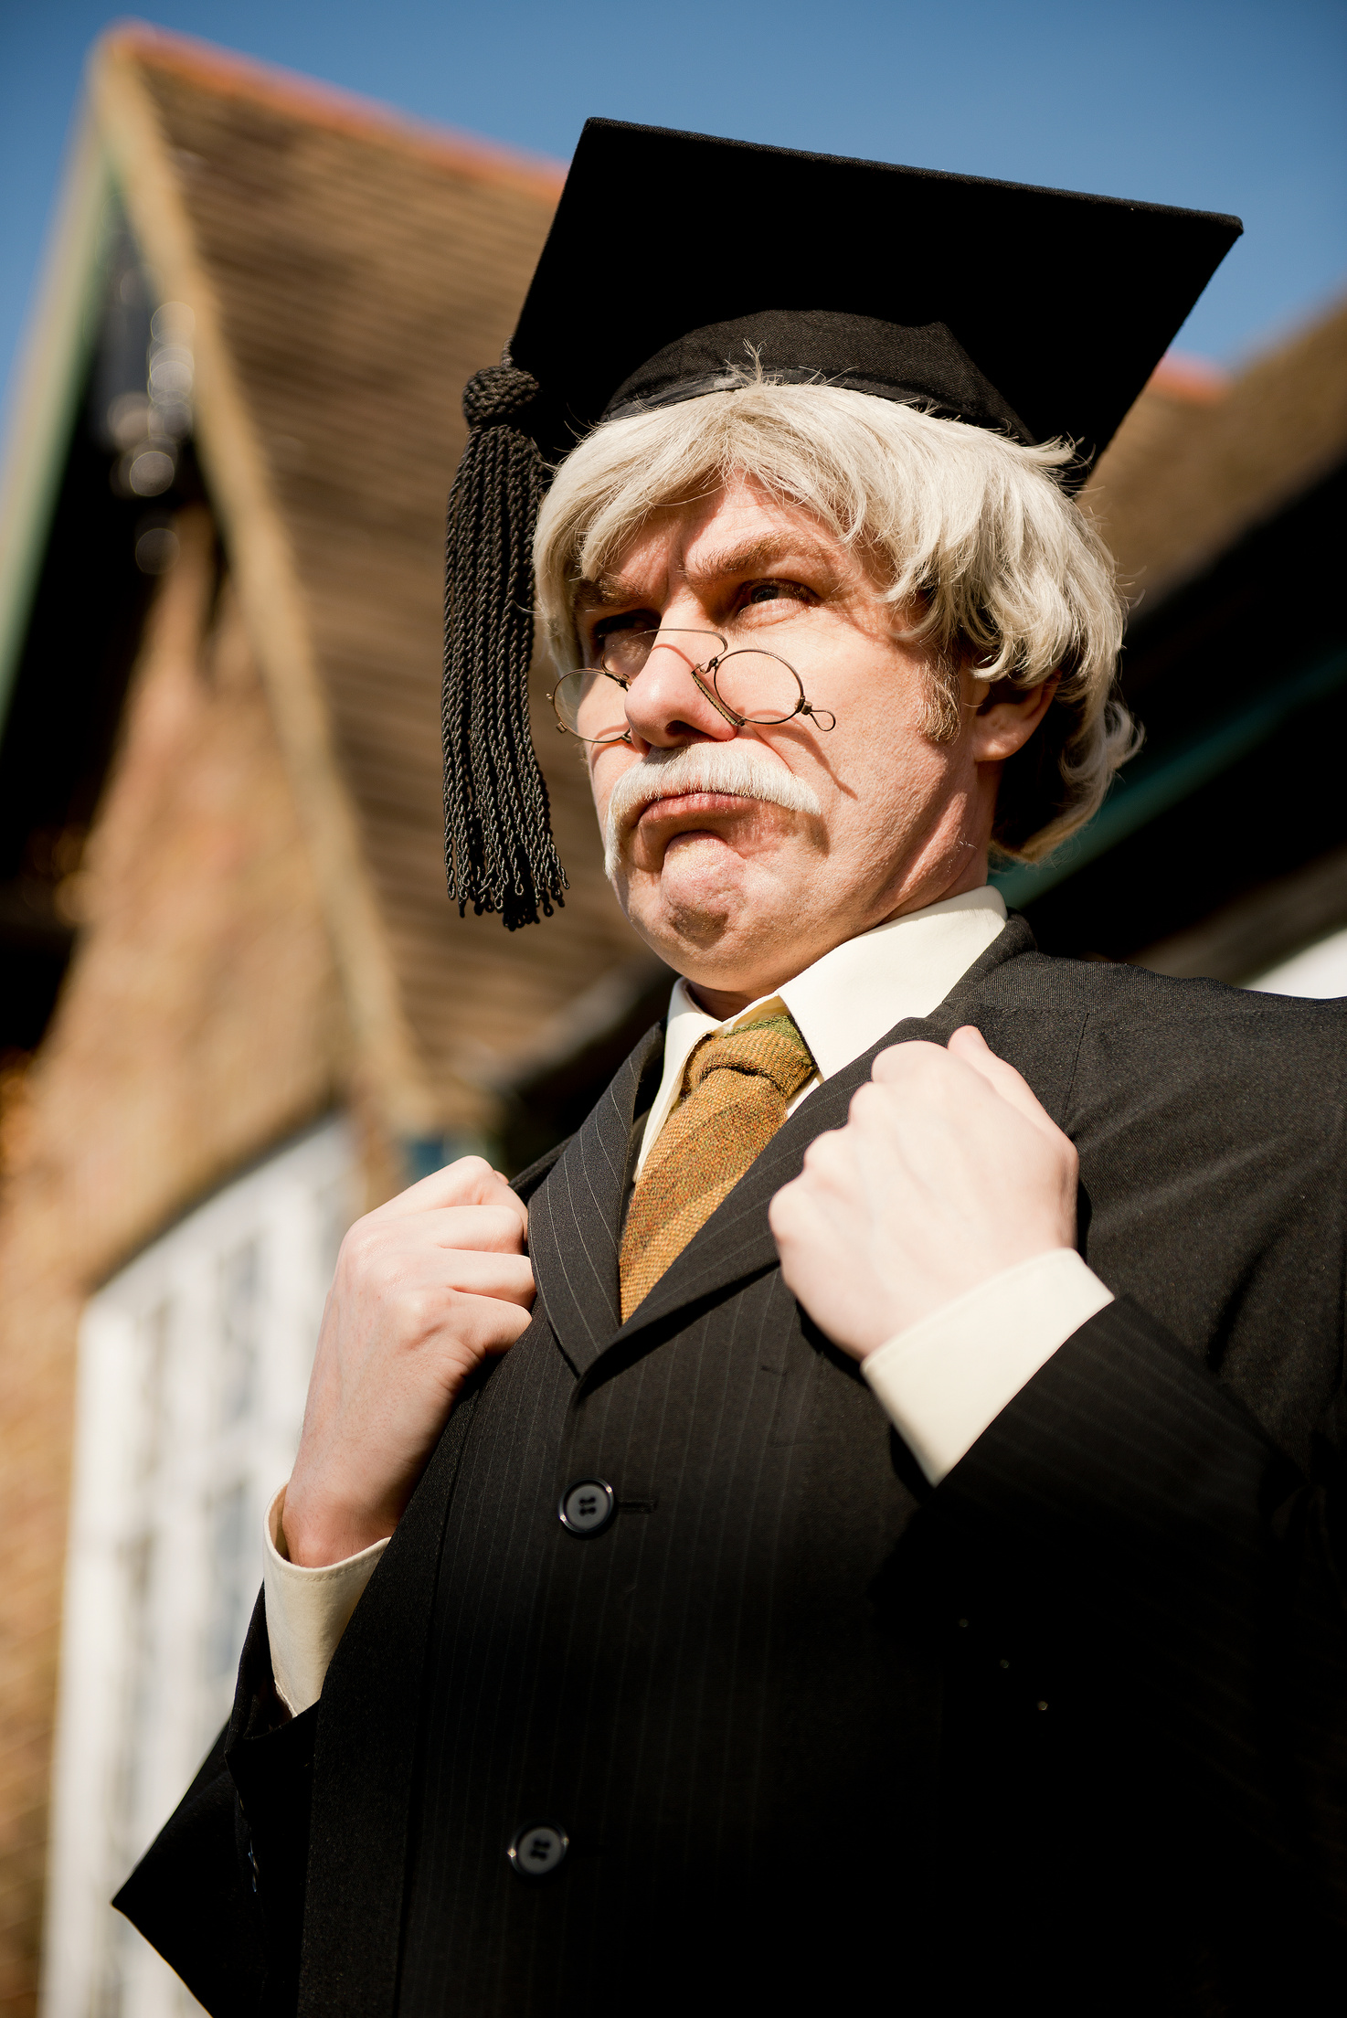


Principal Message
As you stand on the threshold of a new chapter, take pride in how far you’ve come. Your resilience, kindness, and growth have shaped not only your future, but the community around you.
Carry forward the values we cherish in Canada—respect, inclusion, and integrity—and continue to be thoughtful leaders in whatever path you choose. Whether you're heading to university, college, work, or a gap year, remember: your journey is uniquely yours, and each step you take matters.
Congratulations, Class of 2025

Slide 3

Keressa Albertson
Kerissa would like to thank her Mom and Dad for pushing her to get things done and for those hour long 11pm talks. She would also like to thank her boyfriend and friends for always helping her out and being the highlights of the boring and rough days. Lastly she would like to thank God for always being right beside her through everything.
Izaiah Ambrus
I would like to thank Mr. Watson, Mr. Grey, Mark Desautel, Ms. Sviatko, Ms. Giesbrecht, Jake Millar, Amy and many others. I would not have come this far if it wasn’t for all of you.
Courtney Anderson
I want to say thank you to my Mom and Dad for dragging me out of bed.

Slide 4
Thank you to my Dad for always beliving in me and countless hours teaching me math. Thank you to my Mom for always being there. Thank you to Hunter for always pushing me to be my best and allowing me to rant and crash out constantly. Thank you to my sister for being my best friend and answering any questions I have. Thank you to Vimy Yart and Nic for always being by my side. Thank you to anyone who has helped or supported me.
Kallysta
Anderson-Valcourt
After taking a gap year to work and make preparations, I’ll be pursuing a career as either an observational astronomer or a pharmacist. I would like to thank a few staff members at school. Mrs. Heals for being on the of the nicest people I have ever met and creating the most comfortable environment in her classes. Mr. Murray, who despite making fun of me every chance he gets, is probably one of my biggest supporters. And to Nicki Jackson, the backbone of the entire school. Thank you to my mom for dealing with me during the many mental breakdowns I’ve had over my high school years. And lastly, thank you to my best friends, Lily-Anne, Nico and Kai. I love you all dearly and treasure the memories I’ve made with you. Here’s to making many more!
Ashlee Arthurs
I plan to get my Bachelor’s of Science at Thompson Rivers University and a Lab Technology diploma. I want to say a big thank you to everyone who has helped me throughout my high school years.
Hunter Atkinson-Blades

Slide 5
Riley Beharrell
Thank you to Ms. G for making school a little more fun. And I’d like to thank Chelsea and Brody for everything they’ve done for me over the past year. I plan to go to TRU in Kamloops for pipe fitting and plan to go to camp jobs to rake in the money.
Wyatt Benard
I want to thank myself for showing up and putting in enough effort. Thank you to my family and friends for always being there for me. I plan to continue with trades school and become a successful electrician
Delaney Best
No quote submitted.
On behalf of the faculty and staff, we acknowledge this graduate's accomplishments and celebrate this milestone.

Slide 6
My plans are to go to Summit Pacific Bible College where I will be taking a one year youth ministry course to hopefully become a youth pastor. I may also possibly do some photography and art on the side. I want to thank my Mom and Dad. who have made it possible for me to graduate and have continued to encourage me to pursue my dreams. I also want to thank my friends who have brought me through thick and think, always being there for me and never giving up on me. Thank you for me and never giving up on me. Thank you to my former and current youth leaders/pastors who have made me into the person I am today because of their generosity and endless compassion. I want to thank my boyfriend for never leaving my side and loving me unconditionally through everything. Thank you, Mr. Kline, for bullying me (get well soon!), Mrs. St. Pierre for being my yoga buddy, and Mr. Aaslie for being my all - time - favorite teacher. Also, thank you, Mrs. Heales, for being my main inspiration and Mrs. O’Leary for never giving up on us.
Caroline Betuzzi
Infinity Bob
Infinity would like to thank Ms. K, Karen, Amanda, Ms. St. Pierre, and Ms. Currie. She states: "Thank you for helping me with school work and other stuff while at school."

Slide 7
I am sincerely grateful for the support and encouragement I have received from my family, friends and the teachers. I would like to extend a special thank you to my parents, Tiffany and Dean, as well as to Lesley, AJ, Lindsey & my grandfather Melvin and Nana Eleanor for their unwavering support. High school had its challenges but I’m proud of how far I’ve come and everything I’ve learned along the way. I’ve grown significantly with the support of those around me and the experiences that shaped me. This fall, I will be studying kinesiology at Okanagan College with the goal of becoming a physical therapist. After years of throwing, half-warming up with runners and pretending to stretch, kinesiology just make sense. Thank you to everyone who helped me and reminded me who I am along the way. (I haven’t forgotten about my favourite big backs, Jo and Austin, thank you.)
Lauryn Boyce
Ryly Chaffee
Thank you and I’m glad I graduated.

Slide 8
Jujhar Chhina
I appreciate all that my parents have done for me. Without them, I would never be able to do homework and sports. I would also like to thank Marcy for taking me to every tournament!
Ximena Cibrian
I am going to university to become a veterinarian. I’d like to thank my parents who helped me through high school and my friends who made it so fun.
Jack Copley
Jack would like to thank all of his friends for making school kinda fun and for getting him into dirt biking.

Slide 9
Lille Czirak
To my teachers, Joe Vallee and Brenda Grant - thank you for showing me hope in times that felt impossible to get through. I couldn’t have graduated without you guys and your support. Storefront will always have a special place in my heart. To my family - thanks for all your love and belief in me. To all of my closest friends - thank you for always sticking by my side and showing me light in the dark.
The past few years have been filled with challenges, growth and unforgettable experiences. I’ve learned so much about others and who I am as a person. I’m incredibly proud of who I am becoming, and how far I have come in the past couple of years, and most importantly, I’m grateful for everyone who’s supported me along the way. When life gets hard, keep on marching on...
Mohamed Daab
I would like to thank my family and friends for supporting me through high school.
Jayden Daniels
Thank you to the incredible teachers and support workers, Amber and Kathy, whose guidance and encouragement helped me reach graduation. I really appreciate everything.

Slide 10
Tyson Dean
After graduation, I plan on pursuing an education in horticulture at Thompson Rivers University. The goal after getting my Red Seal in Landscaping is to open up my own landscaping business.
Thank you, mom and dad for always believing in me when I didn’t. If it wasn’t for you guys always pushing me to go to school and believing I could do it, I probably wouldn’t be here. I love you guys so much and all the people who helped me through school: Nicki Hansen, for making the best lunches ever, Angel for being my school mom, Ms. Martin for making me feel guilty for not getting my work done, Cathy for giving the best advice, and most of all, Bernice for always stealing my money. One last thank you to the most beautiful girl in the world for always being there for me and cheering me on: thank you.
Logan Dion
I would like to thank my family, friends and teachers for always supporting me. I will be attending George Brown College in Toronto in the fall to pursue a degree in Dental Hygiene.
Allie Donnelly

Slide 11
Calum Dunning
I would like to thank my parents for helping through all my years of school and getting me to this point.
Jeremy Ebert
Thank you to my family and friends for helping me along the way. A special thanks to Mr. Johnson for being a G.
Helena Eleniak
I would like to thank my sister, Anna, for giving me so much support (and being my Capstone mentor). I appreciate the help I have been shown by a few of the teachers here. I would like to thank Mrs. Gardner and Candace. Your kindness has helped me get through the days immensely. Thank you to my dad for driving me to and from school most days.

Slide 12
Lily English
As I close this chapter in my life, I’m filled with so much gratitude for the people who helped me make it through. Thank you to Zita, Sierra, Luke and everybody else who helped me. Your encouragement and support have meant the world to me. Every single one of you has made a lasting impact on me. I’ll carry your support with me into whatever comes next. I truly couldn’t have done it without you guys.
This fall, I’ll be attending Thompson Rivers University to pursue my dream of becoming a social worker. I’m excited for what's ahead and I’m taking all the love and support I’ve received these last 5 years with me.
Cocomi Escott
I would like to thank my mom for helping me through high school and for all of my friends for the memories that I’ll never forget.
I would like to thank my parents for the constant support, as well as my teachers and coaches for their guidance.
Brock Ferguson

Slide 13
Harrison Findlay
In my future, I am planning on going into civil engineering. I would like to thank my parents for always believing in me, supporting me and being hard on me when they had to. Thank you to all of my teachers throughout the years for teaching me and also putting up with me. I also would like to say a very special thank you to my Mossie for always being my biggest supporter and for being the most loving grandmother someone could ask for.
Grace Friesen
Next year, I will be attending Trinity Western University for a Bachelor of Education as well as a Bachelor of Arts. I am very excited to begin this new chapter in my life and I am thankful to have my family, friends and faith helping me through it.
Alex Gauvin
I would like to thank my parents for all their support. Also, I want to say thank you to Mr. Kline for letting me skip because he didn’t want me in his class.

Slide 14
Amarea Giroux
Amarea would like to thank her family and friends who have been there for her throughout high school. She would also like to thank the teachers who helped and supported her during her years here.
Quinlan Grantham
I would like to thank my family for always believing in me. And thank you to all the teachers who work so hard for everyone.
Tomas Grey
I would like to thank my parents, friends and teachers for being cool. Thanks, guys!

Slide 15
I would like to thank my Mom and Dad. Thank you also to everyone who supported me and got me to where I am. A special gratitude to my cousin, Landon Eddy. Your positivity has been and will continue to be, an inspiration to everyone who knew you.
Leighton Grieve
I would like to say a bigger thank you to my parents for getting me through the rough math years. Thank you especially to my Mom for helping me with any assignments that I had trouble with. Thank you Mom, also for helping me and supporting me with all of the troubles I had with my friends. I would like to say a big thank you to my closet friend for always being there for me and always making sure to put me in my place when I was being unreasonable.
Lochlan Grieve
Rayne Hall
I would like to thank Joe, Brenda and Amy for always supporting me and loving me through my schooling. Thank you to my family for forcing me to graduate. I am looking forward to the next chapters of my life. Thanks, everyone!

Slide 16
Olivia Harper
I would like to express my gratitude to my parents, Jason and Paula, and my brother Jordan for always being there for me. I am also thankful to all my family and friends for their love and support. A heartfelt thank you goes to all my teachers who have guided me throughout my school years. I would like to thank Mrs. Meville for helping me rediscover the joy of learning and Mrs. Van Dalen for always taking the time to answer my questions. Most importantly, I thank Jesus for everything He has done in my life. After high school, I plan to study and become a Dental Hygienist.
Jaden Harrison
Major thanks to my mom who’s seen me at my lowest. Without her, I would not be here today. Another special thanks to Joe and Brenda, these two miraculous teachers took me under their wing while I was a lost and troublesome teenager and guided me into the young man I am today. I would also like to thank all of my co-workers at the Iron Horse for showing me all of the kindness in the world and for teaching me the importance of responsibility. I’d like to thank my dad for showing me how to be strong minded and how to learn from my mistakes. One last thank you to my Tia Norma and Tio Rick for stepping in when no one else did and showing me the importance of family. Sincerely, Jaden Harrison.
Cole Hartinger
No quote submitted.
On behalf of the faculty and staff, we acknowledge this graduate's accomplishments and celebrate this milestone.

Slide 17
Kolby Heit
I’d specifically like to thank Mr. Taylor for teaching me how to play rugby. Also, Andrew, Willy and TJ for pushing me to my limit at basketball and rugby and for having my back during the season.
Lily-Anne Henderson
I would like to thank my closest friends who have supported me through every hurdle that life threw at us. Throughout high school, we have been inseparable, we have learned, laughed and cried together and I am so grateful to have friends who let me be my real human self.
Extracurriculars have been a core part of my experience in high school, and I wouldn’t have been able to go to after school events without the loving support and encouragement of my parents. Performing in PSO’s concert band and supporting the GSA club help me to form close connections and gave me once in a lifetime opportunities.
Thank you to the teachers and staff who taught us while making us feel safe and included. Nicki Jackson, Mrs. Van Dalen, Ms. O’Leary, Mrs. Dugaro, Ms. Giesbrecht, Jill Morris and Dawn Jorgensen to name a handful. Thank you for being in my life and contributing to my education.

Slide 18
Eithan Hennigar
Eithan would like to say thank you to Mr. Grey for everything he has done for him and how much he helped him through school.
Emily Hicks
I would like to thank three male figures a part of my life who have done so much for me during this journey. My Dad for always being there to lean on when things got hard and giving the best advice. My boyfriend who has shown me what a healthy relationship is and has helped me with homework and things I need to work on. And finally my younger brother who has seen me at some low points and has hugged me through the tough times and make me laugh during the good and for just being my best friend. I love these guys with all of my heart and wanted to thank them for everything they have done and I couldn’t have asked for any better people to have support me.

Slide 19
Khloe Honeybourn
The only people that I will thank are my teachers. They got me through school even when I thought I couldn’t. They encouraged me throughout my tattoo career and my schooling. I never took my days for granted when I was in Storefront because that was my home. I hope Joe and Brenda know how much they affected my life in such a powerful way. I will never forget my time being in Storefront. I would also like to thank Sydney Honeybourn and Lillie Czirak for showing me I still have light in my heart and always keeping me on my feet. Thank you, guys, love you!
Destiny Hunter
I would like to thank my family and particularity my mother for always supporting and pushing me to be the best version of myself. I will be studying Criminology at Vancouver Island University in the fall. I hope to one day be a police detective and devote my life to helping others. I’d also like to thank all of my friends and my teachers for supporting me throughout high school. This all would not be possible without each and every one of you.
Dani Kerr
I would like to thank my Grandma for teaching me the first half of high school. I would also like to thank Mr. Saban for his support.

Slide 20
Thank you to my friends and family for everything they’ve done for me these past few years. My friends for joking with me on bad days to help me feel better and my family for supporting me and my well - being outside of school. I plan to take a gap year to work as much as I can so I can decide what I want to be in life; hopefully that answer is out there somewhere. Thank you to Ms. O’Leary for always showing me such kindness and I appreciate your effort to be the great teacher you are. Thank you to Mr. Heales for being the teacher every one needs. You’re always up for a joke but won’t hesitate to put your foot down and I appreciate you sparing us from your wrath. Thank you everyone for the wisdom I’ve gained from being here every day (almost).
Jamie Kliewer
Claire Kreschuk
Thank you to my teachers and coaches for the support along the way and to my family for the unconditional love and guidance.
My exact future plans have not been written in stone. I plan to explore some career options of interest and use this experience to guide me. I am very certain that heavy equipment will be involved somehow.
I would like to thank all the people at PSO who have believed in me and helped me. Mrs. Meville, thanks for your perseverance through Math 12, Mr. Taylor for enduring my morning routines, Mr. Kline for always having the time to joke around, Ms. Marten for always believing in me and to the EA’s who have worked tirelessly to keep me focused (ya, I mean you, Glenda.) And lastly I would like to thank my mom and dad. You two have never faltered in what you believe I am capable of and for this I am forever grateful.
Ty Kreschuk

Slide 21
Joelle Kuyek
I will be attending UBC Vancouver to pursue a degree in environmental engineering and training and hopefully playing with the Varsity Rugby team.
Preston Lamy
I am now working at Countryside Equipment as an apprentice heavy duty mechanic. I am working toward my Red Seal.
This fall, I will be attending TRU to do a year of post secondary in their Bachelor of the Arts program. Through that program, I will be able to attend BCIT in their sonography program. I would like to thank everyone who is helping make this dream of mine possible. Thank you to my mom and siblings for encouraging me and pushing me to further my career goals. I would also like to thank Kam Taylor for always pushing me to new limits; you saw what I couldn’t see in myself and helped me reach goals I couldn’t have imagined before. I would like to thank Rick Barker: even during our last season together, Rick had struggles of his own but showed up and supported the team no matter what. I would like to thank you for your kindness and support on and off the court. I means more than you can imagine. Lastly, thank you to all my friends for making high school as fun and adventerous as I always imagined. Best of luck to everyone and a successful future!
Skylinn Larson

Slide 22
Gracie Larson
A big thank you to my Auntie Nick and Heather Wood for always being there to answer my millions of questions every single day no matter how annoying it got.
Thank you to my friends and family for standing by me through everything, cheering me on through every challenge and celebrating every small victory along the way. And thank you for always support me as I take my next big step into health care.
Wil Law
Thank you to my friends, family and the teachers that I liked, especially Floof and Mr. Johnson.
I’d like to thank Ms. Van Dalen for always dealing with me being late and just dealing with me in general. (I’m a lot to deal with.) I appreciate always being checked on, and I did the math...you owe me $37 for all the cookies. I bought you for being late. The next teacher I’d like to thank is K-Dawg (Mr. Heales), even though you’ve only been my teacher once. I’ve disturbed your peace WAY too many times. You’re welcome buddy! I finally want to say I am feeling very Gaberific today Mr. Heales: thank you K-Dawg! I also, would like to thank Bernice and Ms. Trapp. Thank you, guys, for always letting me complain about almost everything and I mean EVERYTHING. Thank you, guys, for being in my life. A FINAL thank you is to Kline and St. Pierre. Kline, thanks for being the sassiest man I know and I’ve really enjoyed my months of peace (JK, dude, how dare you!) St. Pierre, I’m gonna miss doing literally nothing in your class (my fault, not hers). I might as well mention my future plans: I’m going into economics as well as international relations. After that, I’m going into law school. I love arguing with people, so I might as well get paid for it. Thank you all, for being there for my whole high school experience. PEACE!
Gabby Machete

Slide 23
Briley MacNeil
I would like to send a big thanks to my local fast food hangouts. I would also like to thank Dodge for being a gloried shipping crate for Cummins. I would like to thank Chevy/GMC for making the god awful 4260. I would like to thank Ford for making the 6.0/6.4 powerstroke AKA the most unreliable trucks. Final thank you to the dinosaurs for dying making it possible for the clapped out shipping crates to stay in motion - wise words from Briley James MacNeil. PS - Don’t drive a Ford!
Nathan Madsen
Big ups to my mom and Pops for putting me back on track.
A big thank you to Nicki Hansen. You made a huge difference in school for me. Thanks to all my friends throughout; school you made it less lame. I’m gonna miss all my friends I’m leaving behind and I’m looking forward to making money and figuring out my next chapter in life. I hope everyone flourishes in their life - paths and continues to grow throughout the years. See ya, wouldn’t wanna be ya!
Carmen McDermid

Slide 24
Cameron McNeil
Cameron would like to thank his mom, dad, and his sister, Leah. As well, he would like to thank Travis, Beau, Quin and Mr. LeFlufy.
Hailey McNeil
Thank you to my parents for always being there for me, to my brother for his good advice, to the friends who stuck with me and to my teachers for putting up with me. I will be studying computer science at TRU this fall.
I am very proud of have finished my carpentry foundations program at TRU and am looking forward to starting a career in carpentry. I would especially like to thank my Mom, Mr. Grey and Izaiah Ambrus. Without them, I don’t think I would have made it this far in life.
Jake Millar

Slide 25
Alexis Neels
I would like to thank my family for everything they have done for me throughout my high school years and to thank my soccer coaches and teammates for dedicating their time and effort through high school for our girl’s soccer team.
Alexa Ohlund
I would like to thank my friends and family for always being there.
I would like to say another huge thank you to my best friend, my mom for always being there to help me with anything and everything I struggle with. She has always been here for me through the highs and lows and I am forever thankful for that.
Charlotte Oliver

Slide 26
Ahmed Omer
I want to thank my family, friends and teachers for helping me get through high school. And would also like to thank my coaches and Mr. Barriault for always being there for me in my life.
Colby Ouellette
Thank you to my mom for constantly giving me ideas and inspiration for my projects and future. Also to my online friends for constantly giving me motivation to keep going. After all of this, my main goal is to become an electrician, but with all the skills I have, I can go into anything.
I would like to thank Nicki Hansen and Heather Wood for all their support and keeping my temper in check. My biggest thank you is to Ms. Marten for putting anything aside to help me and never giving up even when I did. I’ll never forget you. My future plan is to go play hockey in Chilliwack and aspiring to play college hockey.
Josh Paddison

Slide 27
Kai Patterson
Kai would like to thank her mom and dad, her friends Lily-Anne Henderson, Ashlee Arthurs and Nico Schroevers, as well as Nicki Jackson. Kai would also like to thank herself for surviving high school!
Ivan Pincott
After high school, Ivan plans on making money and having fun.
I’d like to thank my friends and family for standing beside me through these last few years. I’d also like to say a big thank you to Mr. Kline and Mr. Aaslie for always accepting my late assignments, and for pushing me to better myself. Thank you to my parents for always supporting me, no matter what. And the biggest thanks of all to my older sister Abbey, for being the reason I have made it this far. After finishing my journey through high school, I will be attending Blanche Macdonald for the Medical Esthetician program. Again, a big thanks to everyone who has stood behind me, supported me and helped get me to where I am today!
Paige Reeves

Slide 28
Thanks to my Mom and Dad for all their endless support throughout all my school years, I couldn’t have done it without you both. Mom your persistence for me to get through school, all the endless school meetings, homework help...the list goes on, and I thank you. Thanks to all my grandparents for the guidance and support! All my teachers that believe I could do it, Ria Tromp and Chris Saban you both were amazing mentors and teachers. You seen my capabilities and pushed me to be my best and try my hardest (even if I pushed back a little bit) THANK YOU! Congratulations to the class of 2025, I’m out of here!
Gage Riggs
This fall, I plan to go to TRU to study in the Bachelor of Arts program, where I will major in social work, which has been a dream of mine for many years and I want to thank all the people who got me to this point. Thank you to my mom and dad for always being there for me and helping me throughout life. Thank you, Amelie, for always being my best friend and sister. Thank you, Steven Keller, for taking so much time out of your life to coach our team and teach me and others new skills and improvements. Gerardo, thank you for being another great coach; you have taught me lots about patience and kindness. Thank you to my teachers, Ms. St. Pierre and Mr. Heales, for teaching me important lessons and making classes fun. Everyone in my life has had a strong impact on me, especially my friends and family and I want to thank you all again for making everything possible.
Eva Rosenstock

Slide 29
Noah Salaymeh
I want to thank my mom for waking me up everyday. And thank you to my friends for the life - long memories. And to my airpods for carrying me the last 5 years of school.
A big thank you to my amazing parents, grandparents, Courtney, Rae-Lynn, my siblings, all my aunties and uncles for supporting me through everything. I will be going to Sprott Shaw College for Vet Assistant, then a big animal vet. I wish you were here to see me graduate, Poppa.
Daizey Sankey
Aidan Schmid
I want to thank me for believing in me, for doing all of this hard work, for having no days off, for never quitting, for always being a giver and for trying to give more than I receive, for trying to do more right than wrong, and for just being me at all times.
Jamie Schmidt
I would like to thank my teachers, friends and family with a special thanks to my dad for encouraging me to go to astronaut school, which I will NOT be doing.

Slide 30
I would like to thank my mom, step mom, dad and step dad for pushing me to do my best in everything I’ve done. I would also like to thank K-Dawg, Denise, Mrs. Trapp, Kline, Mrs. Heales, Miss Yang, Miss Giesbrecht and Mr. J for making school actually fun. Shout out to Kliners and K-Dawg for always letting me complain. I would also like to thank my friends for always being by my side and forcing me to do my homework. Also, thank you to Nicki and Heather for always having food and giving out forks. And last but not least, I would like to thank my big sister, Jeralyn for being the biggest role model in my life -love you Jer Jer.
Mackenzie Shepherd
Aside from my thank you at the grad ceremony, I’d like to thank my sister, Gracie for being the person I could go to about anything, knowing she’d always have my back. And to my boyfriend, Aiden Hansen, for supporting me through the highs, the lows and everything else in between. I am so grateful for you guys and couldn’t have done it without you.
In 2026, I plan to attend esthetician school/esthetic programs to become a licensed nail/lash tech and much more. I am excited to see where my future takes me!
Chloe Shewchuk
I thank my family for being there and being supportive these past few years here, as well as my friends. I would also like to thank Heather and Nicki; without them I would not be graduating this year and they are the sole reason I get to. Thank you to the teachers who made me excited to go to their classes and properly took the time to help and care; teachers like Ms. Marten, Mr. Mackenzie, Mr. Kline, Ms. St. Pierre and Mr. Heales.
Hannah Shimmin

Slide 31
My plans after graduation are to attend Thompson Rivers University’s Bachelor of Science program in the fall and work my way toward obtaining my degree as a registered nurse. I want to thank my mom and dad for being my biggest supporters and always motivating and inspiring me to do my best. I would also like to give a special thanks to my sister, Julia, who has always been there for me and has been my best friend since day one. I couldn’t have done it without you.
Aubrey Siclari
I want to thank my friends for all the fun memories made. I want to thank my family for always being there and always trying to help in any way they could. I want to thank my teachers for always being there and always trying to help in any way they could. I want to thank my teachers for always putting up with me and getting me through every year and class. I want to thank my coaches and team for all the memories and lessons that they taught me. Lastly, I want to thank everyone else who have been there and supported me.
Dalton Smith
Thank you to everyone who helped and supported me throughout high school. This summer, I will be fortunate enough to join 100 Mile Initial Attack Fire Crew and will be beginning post secondary at the University of British Columbia Okanagan this coming September.
Maxi Springmann

Slide 32
I would like to thank my friends and family. Thank you to my parents who’ve shown unconditional love and support, making sure I have a proper education and a happy home to return to. As well, my grandparents who helped with many rides, meals and homework. Without my amazing friends, I would have never had so much fun in school. They always made school a place to be excited about. And finally, I would like to thank my teachers who always made sure I was learning and growing. Thank you for preparing me for the next steps.
Maddie Squires
No quote submitted.
On behalf of the faculty and staff, we acknowledge this graduate's accomplishments and celebrate this milestone.
Brook Stephenson
I want to thank Mom, Dad, Grampa, Reese, Clayton and Candace more than anyone else for teaching me way more than school ever did and actually helping me with my problems. Kliner, Fluf, Grey and Mr. Aaslie are the ones who I actually learned a little something from. Thank you for the support and pushing me to where I am at now.
Hayley Stobbart

Slide 33
I want to thank my dad for how much you have sacrificed for me and how you always strive for me to be better; your help has made my dreams and plans possible. I also want to thank my mom for never giving up on me and for helping and supporting me through everything. I also want to thank Ms. Van Dalen for helping me through my physics and pre-calculus. My plan after school is to attend TRU and start the engineering transfer program and then later transfer to a different school to get a degree in engineering.
Lincoln Sutton
To all the teachers who taught me during my time here and to my mother and father and to Heather and Ria. Thank you.
Lachlan Tanner
I want to give an extra thank you to the coaches and teammates of the PSO Eagles (Spelqwers) rugby program. All of these people encouraged me to try my best at something new, and gave me another place and outstanding community where I felt like I belonged. My last two years of high school wouldn’t have been the same without the rugby program.
Emily Thain

Slide 34
Emma would like to say thank you to her friends, family and coaches for supporting her through school and making her years playing sports so enjoyable.
Emma Theuring
Tanner would like to thank his parents, grandparents and his girlfriend for their love and support and for believing in him.
Tanner Tillotson
I would like to thank my family for pushing and supporting me. I would also like to thank my friends for being there with me along the way.
Isaac Todd

Slide 35
Thank you to my stepmom, Marcy, and my dad for helping me through these years and thank you to my sister, Kirsten, for helping me no matter what.
Ryan Tofsrud
I would like to thank all the people who have helped and supported me throughout my high school years, especially my parents. Thank you!
Holly Tupper
I would like to thank my mom and dad for all their endless support, love and encouragement throughout my high school experience, for always believing in me and for pushing me to reach my full potential. Also, thank you to my family and close friends who were with me on this journey and to all the teachers who helped me through school. This fall, I will be attending Thompson Rivers University where I will be doing a four year Bachelor of Arts program that I am looking forward to.
Yolanda Turcanu

Slide 36
Noah Udall
Shout out to my parents and all the teachers who had the misfortune of teaching me.
Johan would like to thank his parents, friends and girlfriend for accompanying him throughout high school. Most of all he would like to thank God that he has the privilege to attend PSO.
Johan Van Der Westhuizen
Thank you to all the awesome staff for supporting me through my journey of high school. I wouldn’t be here without your guidance. Because of you, I’m now ready to embrace the unknown and make the most of every opportunity. To my friends who have been there the whole way, thank you for being by my side when I needed it the most. The journey ends here, but the adventure begins. Class of 2025, let’s make it count!
Dante Van Hoof

Slide 37
I’m going to TRU Kamloops for a Bachelor of Science, then pursuing futher schooling for a career in sports medicine. I want to give a special thanks to my mom and dad for allowing and pushing me through anything I strive to do as it has made a giant impact on who I am as a whole. I would also like to thank the people I’ve had the pleasure of calling coaches, as each and every one of them has grown and devloped my skills, interest and love of the sports I’ve been so genoursly able to play. On top of being a great teacher, coach and mentor, I want to thank Mr. Taylor for being such an amazing person in general. He is someone I have a ton of respect for, seeing him give all he’s got for everybody and he has been a great role model to look up to and model myself towards. I also want to thank all of the friends who have been there for me, whether old or new. There is a group of a few guys I’ve had the pleasure of getting closer with and sharing experiences together to laugh with, have a serious conversation with and overall just being good friends.
Oland Vickers
Thank you, Mom, for constantly supporting me and lending an ear for me whenever I need it. Thank you, Dad, for working so hard for me and the family; you’re the hardest working person I know. You guys are the reason I’m here today and am who I am. Thank you, Devlin, you are so annoying sometimes but you really are my best friend and you keep my life interesting. I obviously have to personally thank Ali because you’re who I strive to be and have taught me everything I know. Lastly, I’d like to thank my older brothers protecting me and tormenting me at the same time.
Ryleigh Walker

Slide 38
Cassidy Wall
After graduation, I am moving to England and taking a gap year as I am not sure what I am going to do yet. I am currently looking into pursuing education in the future. I want to thank Mr. Aaslie and Mrs. Meville for providing me a fun environment where I could be myself. Thank you, Mrs. Meville for teaching Anatomy and Physiology this year and making it so fun. I really enjoyed the circulatory unit, DNA and reproduction unit. Thank you, Mr. Aaslie, for all the laughs and cafe - style classroom feel. I also want to thank Daylee Whyte for always being there with me and never leaving. She has been a friend I met in Grade 8 and she is still one of my closest friends because she stayed. Thank you to my parents for supporting me over the years. I also want to say thank you for all the memories that my friends, family and teachers have shared with me. It’s odd to think 5 years have now passed. Thank you for all the great years.
Thank you to Bernice for always brightening my days, Ms. Trapp for helping me when I needed it and my mom and dad for getting me through school.
Luca Weir
Colin Wells
I’d like to say a huge thanks to all my teachers, especially my favourite ones....you know who you are. A special shout out to my home - slice, Ray Kliner!
I’d like to give an additional thanks to my family for all their support. My future plans are to continue with my electrical apprenticeship, and hopefully one day, get my Red Seal Certification.

Slide 39
Daylee Whyte
I am enrolled in Trinity Western University for the fall, for the Bachelor of Arts in Biblical Studies in hopes to become a youth pastor and do firefighting in the summers. I am grateful for all of the teachers who have guided me along the way and cheered me on through all my struggles I have been faced with. I want to thank my family, youth group family, the Duits family and my extended family as I wouldn’t be here without them. Thank you to Mr. Murray for granting me the chance of being in the Jr. Fire Defence course and pushing me to be the leader I am today. I want to thank Mr. Grey for always making smiling easy with his terrible dad jokes he always shares with me and making my day even just a little bit better. If there is one thing that I have learned since being in high school it is that it is okay to be different; it just means you will always be remembered. And finally, I would like to thank Rick & Marci Barker, Ray Berryman and my basketball team for an incredible year. Thank you to my coaches for never giving up on me even with my funny injuries and pushing me to be strong and power through and become my best.
Hunter would like to thank Caroline Betuzzi, his father, everyone at Lake of the Trees and Jesus Christ.
Hunter Wilson
Rachel Wilton
I’d like to thank Ms. Van Dalen for making math understandable and getting me through pre-calculus; Mr. Aaslie for always being so chill; and Mr. Heales for keeping me on my toes. I’d also like to thank my parents for being so supportive and encouraging me to go and become a nurse. I could never have gotten through high school without the help I received from my parents and my teachers. Thanks, everyone!

Slide 40
Emma Yang
I would like to thank my parents for always supporting me and my friends for always being there for me. Also, to all my teachers throughout high school. My future plans are to attend UBC for science and hopefully become an MRI specialist.
Ethan Yates
I would like to thank my family.
Lukas Zytnyk
Lukas would like to thank his family and teachers for supporting him and his growth throughout his high school career. Lukas states: "I wish you all the best for the future and I will continue to strive to do my best in any future endeavors.”

Slide 41


Thank You
You've faced chaos, change, and the dreaded group project—and still, you showed up, grew, and conquered. Your resilience, creativity, and memes gave us hope (and maybe a few laughs we really needed).
We're proud of you—not just for graduating, but for becoming the kind of humans the world actually needs.
Keep going. Keep growing. And maybe call your mom. She worries.
Thanks, grads. You did the thing—and you did it brilliantly.

